Slide 1
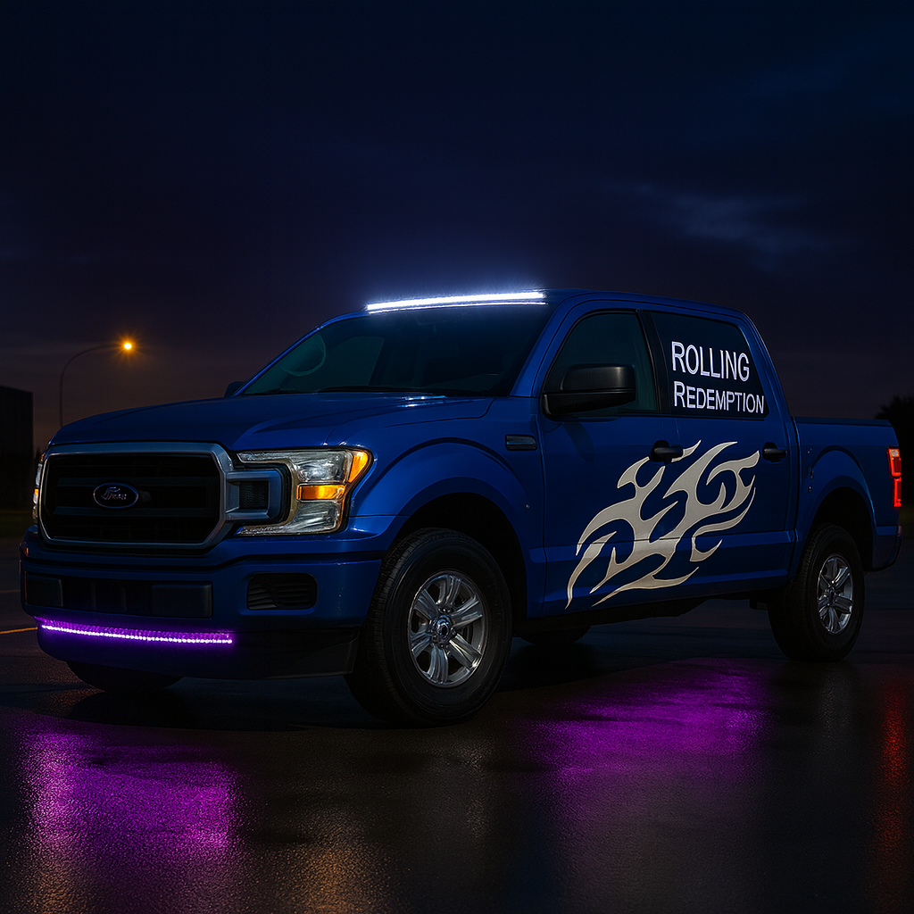
Rolling Redemption
Second Chances on Wheels — Founding Vehicle Opportunity

Slide 2
The Need
Payoff Balance: $15,542.95
VIN: 1FTEW1EF7FFA45546
Mileage: 171,080 miles
Base: Tooele County, UT

Slide 3
Cost Breakdown
Truck Payoff: $15,542.95
Minor Repairs (tires, brakes, fluids, inspection): ~$3,000.00
Vehicle Wrap (sides + rear, commercial grade): ~$3,500.00
Total Founding Vehicle Ask: $22,042.95

Slide 4
The Solution
• Rolling Redemption trains and places CDL drivers from disadvantaged backgrounds.
• This pickup is the operational backbone: towing training trailers, transporting equipment, outreach.
• It becomes a moving billboard of second chances.

Slide 5
For Credit Unions / Banks
Loan Request: $15,542.95 (Collateral: F-150 title)
Repayment Options (example):
• 36 months ≈ $488/month
• 48 months ≈ $380/month
• 60 months ≈ $317/month
Rolling Redemption has partner interest and a 3-city pilot plan.

Slide 6
For Sponsors / Employers
• Exclusive co-branding on the first Rolling Redemption vehicle
• Visibility: truck wrap + media coverage
• Recognition as “Founding Vehicle Sponsor”
• Early access to trained CDL grads for hiring pipeline

Slide 7
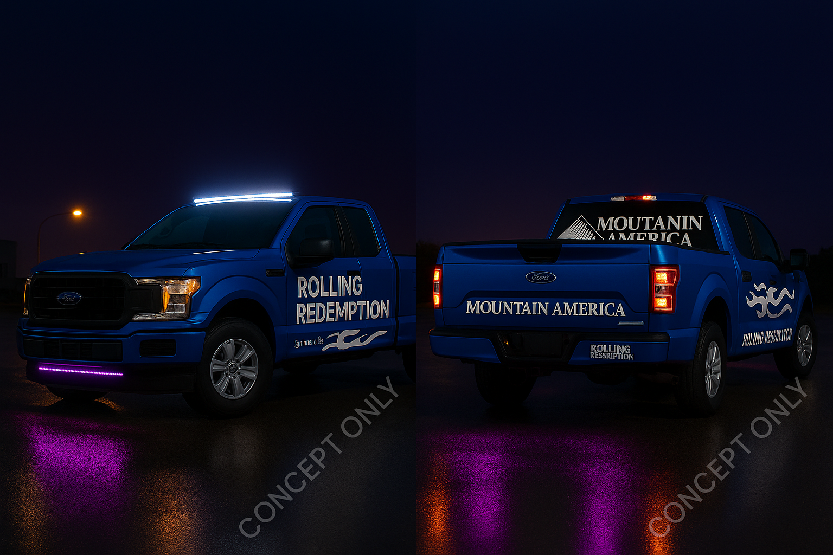
Wrap Mockups — Mountain America CU

Slide 8
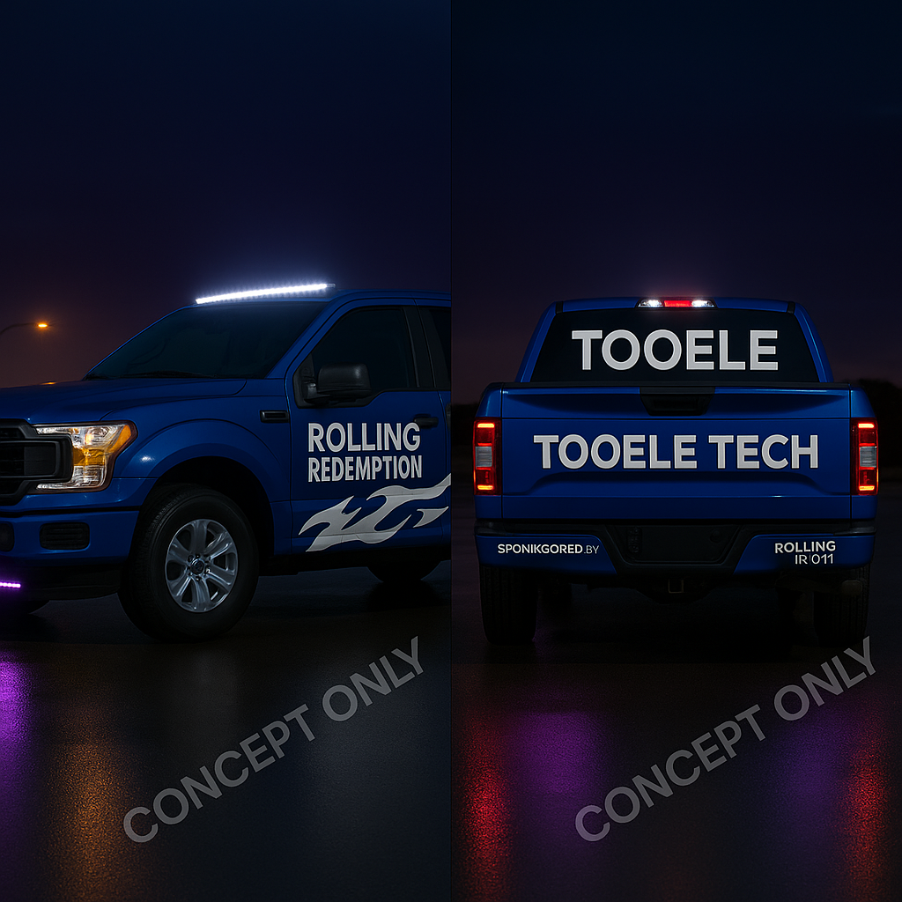
Wrap Mockups — Tooele Tech

Slide 9
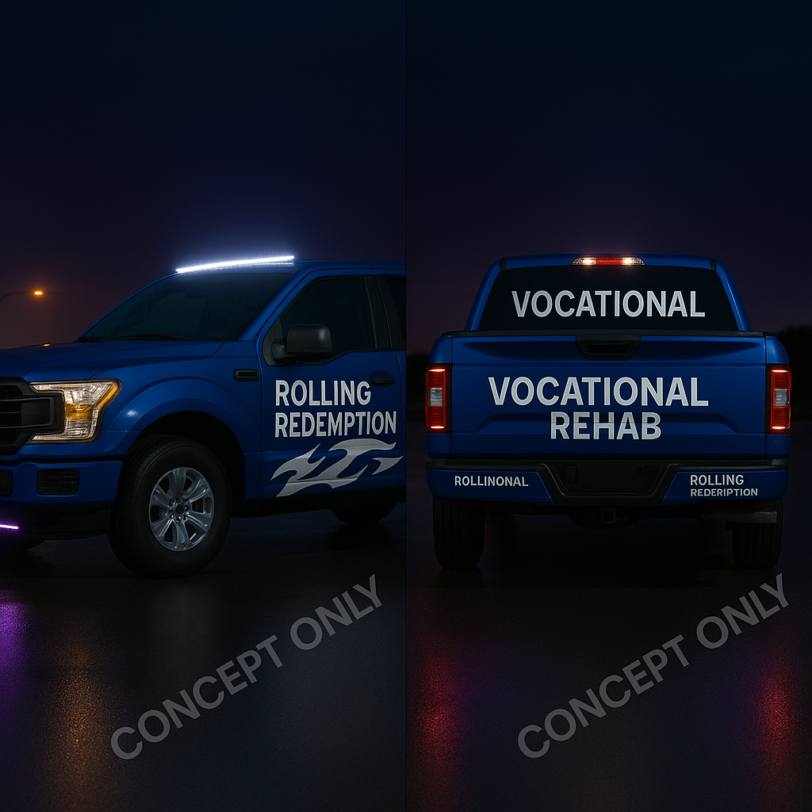
Wrap Mockups — Voc Rehab

Slide 10
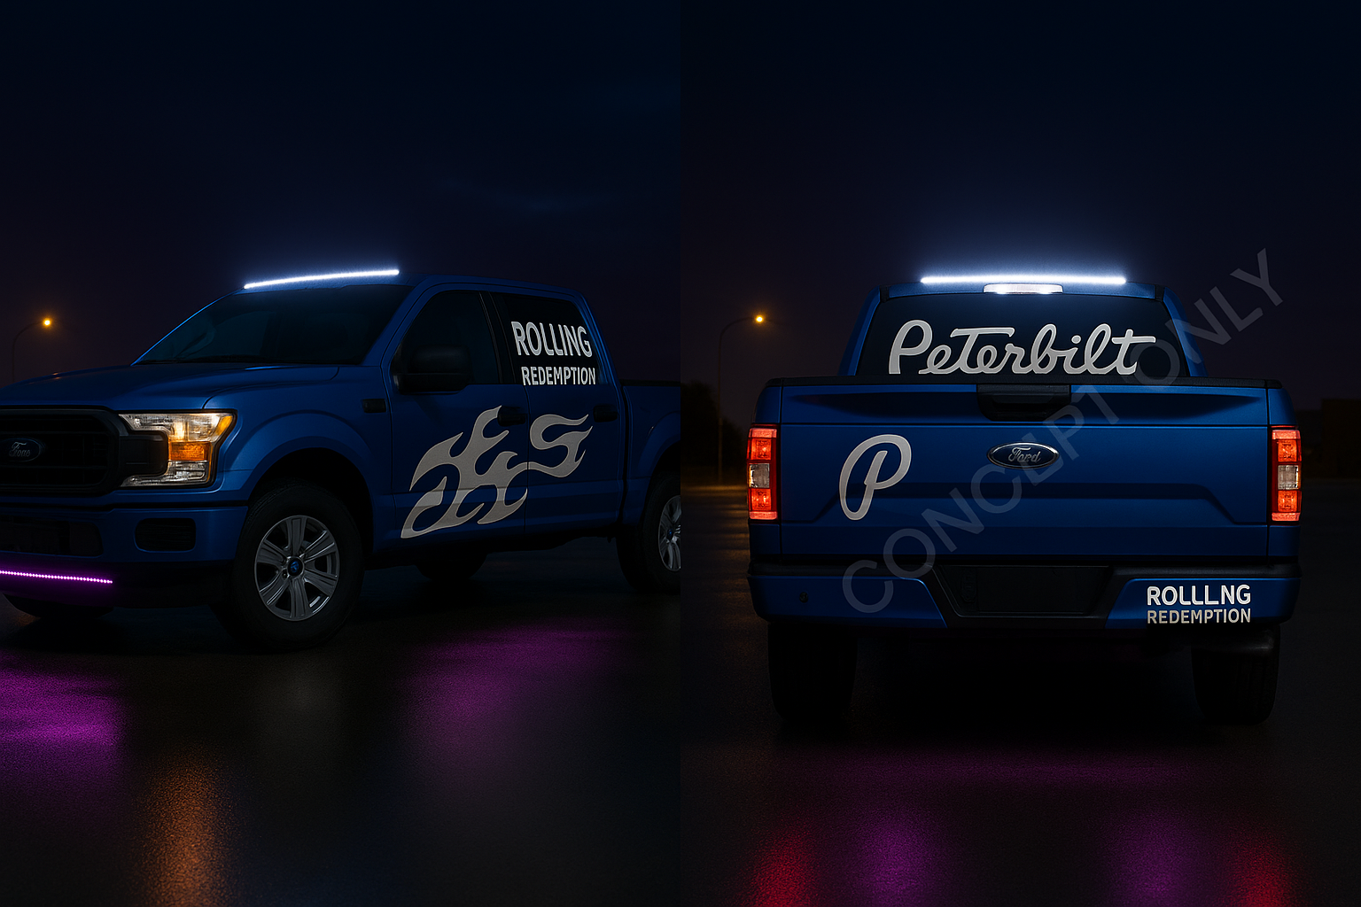
Wrap Mockups — Peterbilt

Slide 11
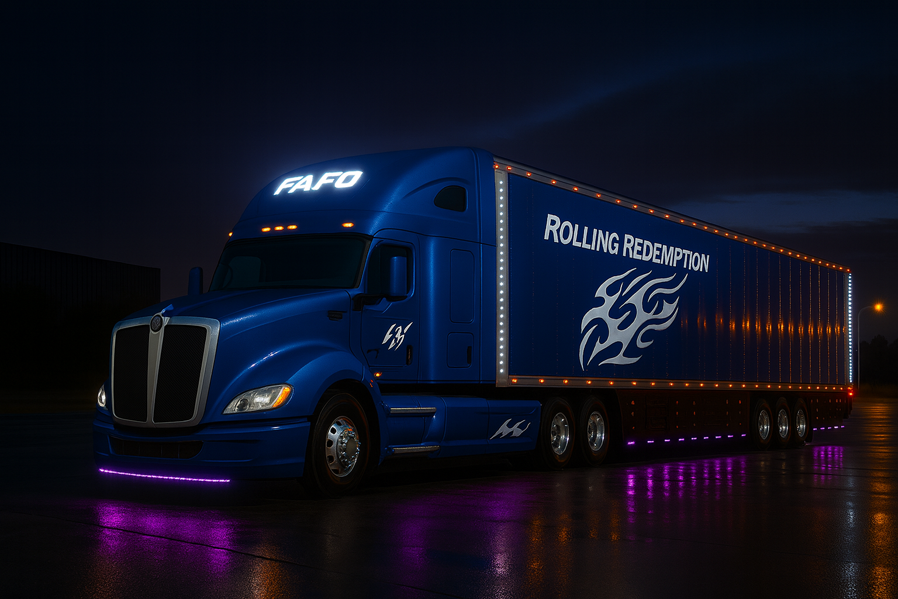
Your Moment to Act
Whether you are a CU, sponsor, or connector — this pickup is the visible start of something bigger.

Slide 12
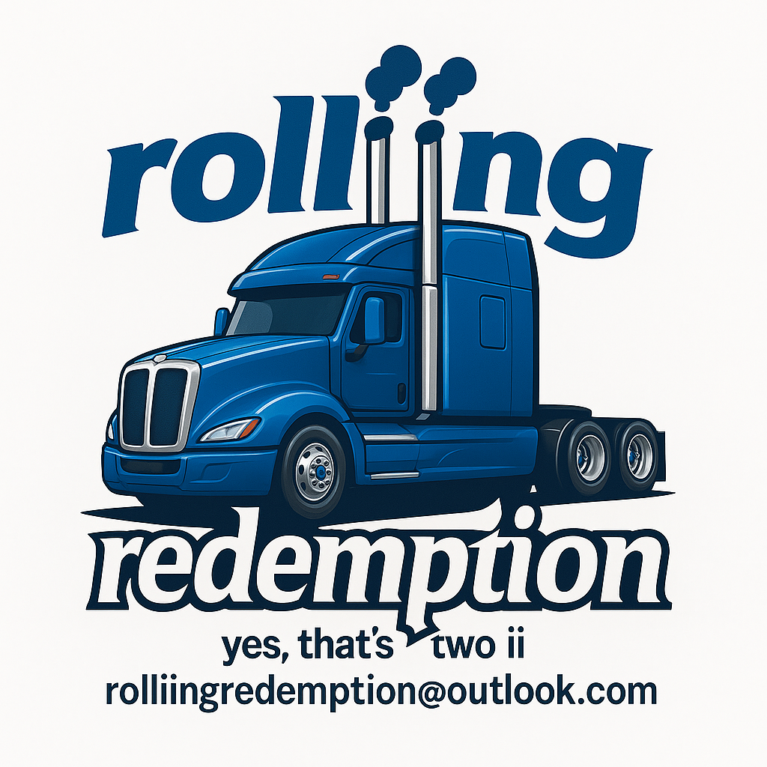
Contact
Driving Workforce, Driving Hope
Fundamentally Aided by OpenAI

Slide 13
Rolling Redemption — The Road Ahead
Phase 1: F-150 Founding Vehicle → payoff, wrap, deploy
Phase 2: Fleet Expansion → vocational trucks, training trailers
Phase 3: Workforce Pipeline → CDL grads, employer partners, reduced recidivism
Phase 4: Scaling → replicate in other counties/states
Second Chances on Wheels — From One Truck to a Movement

